Slide 1


A wind tunnel for kids…
Status Update
March 29, 2012

Slide 2
Activities this week
Android development
Continuing to add functionality to Arduino communication classes
Physical tunnel development
2 temperature sensors created

Slide 3
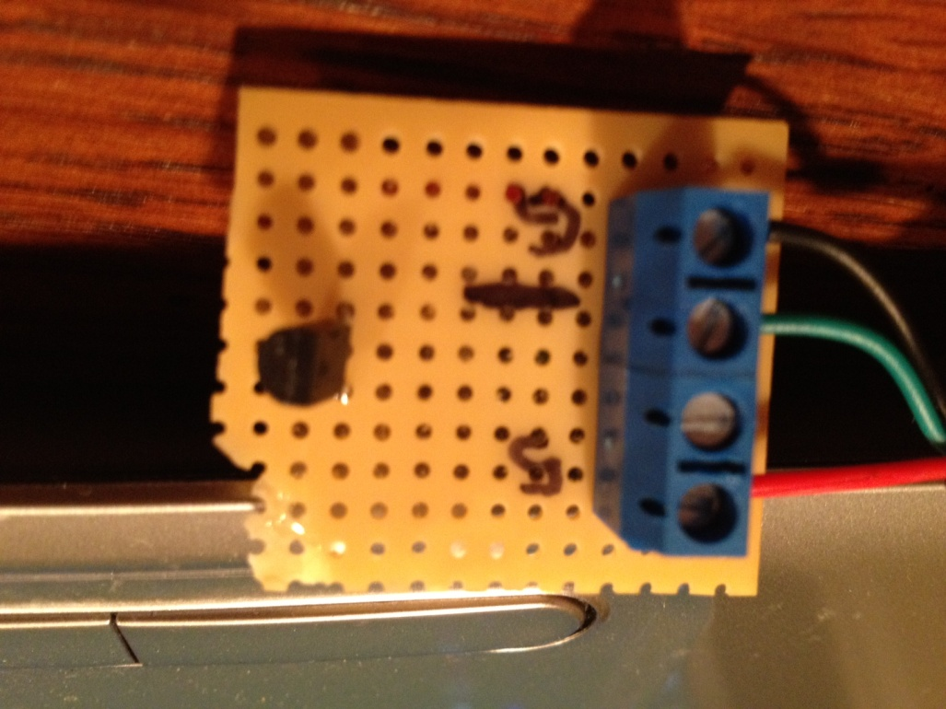
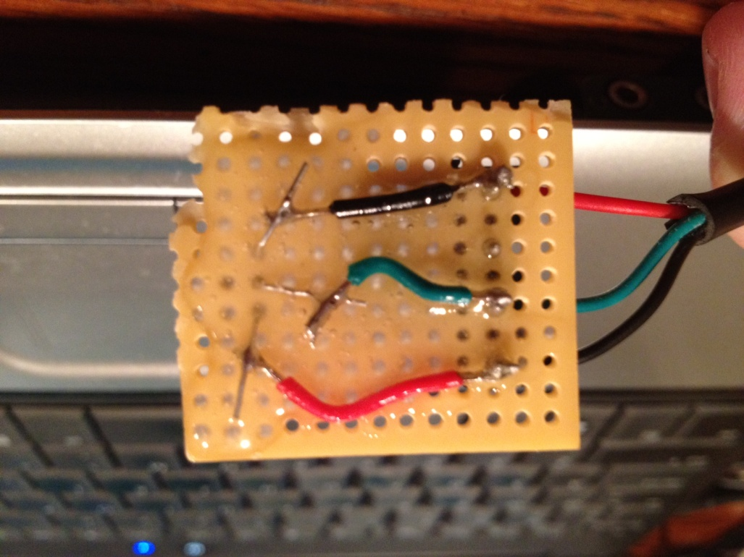
Temperature Sensors

Slide 4
Baseline Documentation Metrics
Metric | Value | Notes
# Developer Documents | 116 | SoW, SDP, SRS, SDD, Fall FQT, Javadocs
# Administrator Documents | 0
# Pages | 158
# Status Presentation Slides | 127

Slide 5
Baseline Code Metrics
Metric | Value | Notes
SLOC (Physical) | 9203
SLOC (Logical) | 8073
# Source Files | 114 | File types included: .h, .cpp, .java, .xml, .pde, .ino

Slide 6

Baseline Hardware Metrics
Metric | Value | Notes
# Sensors Prototyped | 3 | Temperature, Humidity, Hall Effect
# Control Elements Prototyped | 2 | Motor Control, LED
# Sensors Integrated | 2 | Temperature, Hall Effect
# Control Elements Integrated | 1 | Motor Control

Slide 7


Follow us on Twitter… 7 followers – 47 tweets
@TunnelK
Notes:
Initial social network of choice…

